Slide 1
ChatGPT vs DeepSeek: A Comparative Study in Professional and Non-Professional Use
A comparative study in professional and non-professional use.

Slide 2

TEAM MEMBERS
ABDULLAH AYUB
BSDSF24M029
SUFYAN AHMAD
BSDSF24M018

Slide 3
👥 Overview : This research investigates user preferences between ChatGPT and DeepSeek across professional and non-professional contexts. It highlights: Usability differences Perceived accuracy and speed Use-cases in education and work Trust in information and reliability

Slide 4
📝 Survey Details : Total Respondents: 160+ Method: Google Forms Target Group: Students and working professionals Focus: Tool comparison in terms of functionality, reliability, and use-context

Slide 5
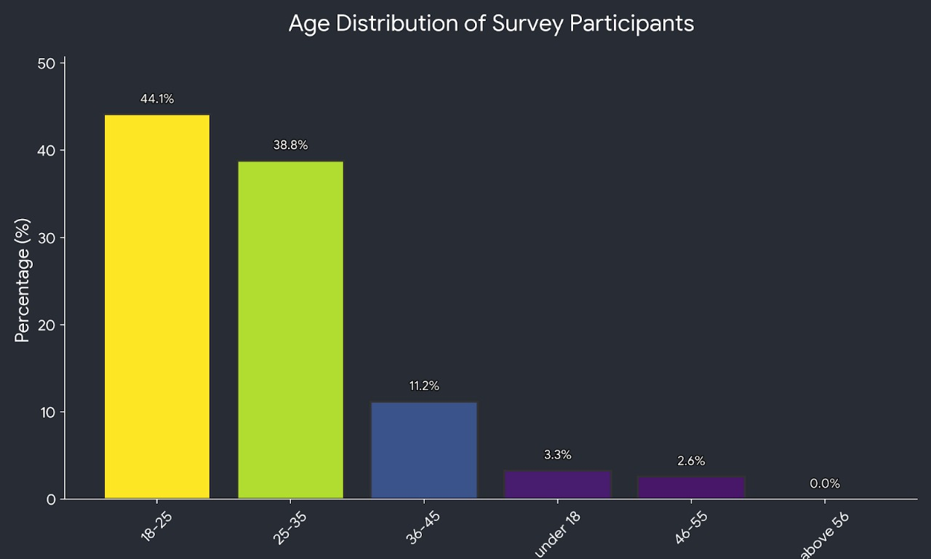
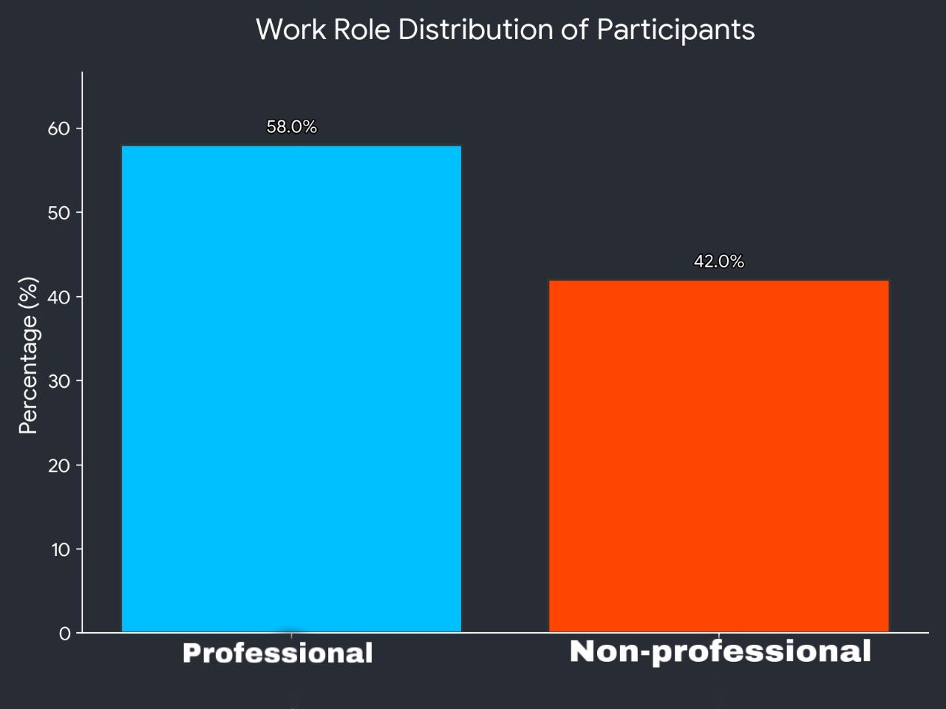
SURVEY STATS
b. ROLE DISTRIBUTION
(PROFESSIONAL/NON-PROFESSIONAL)
a. AGE DISTRIBUTION ( Sample 160 )

Slide 6
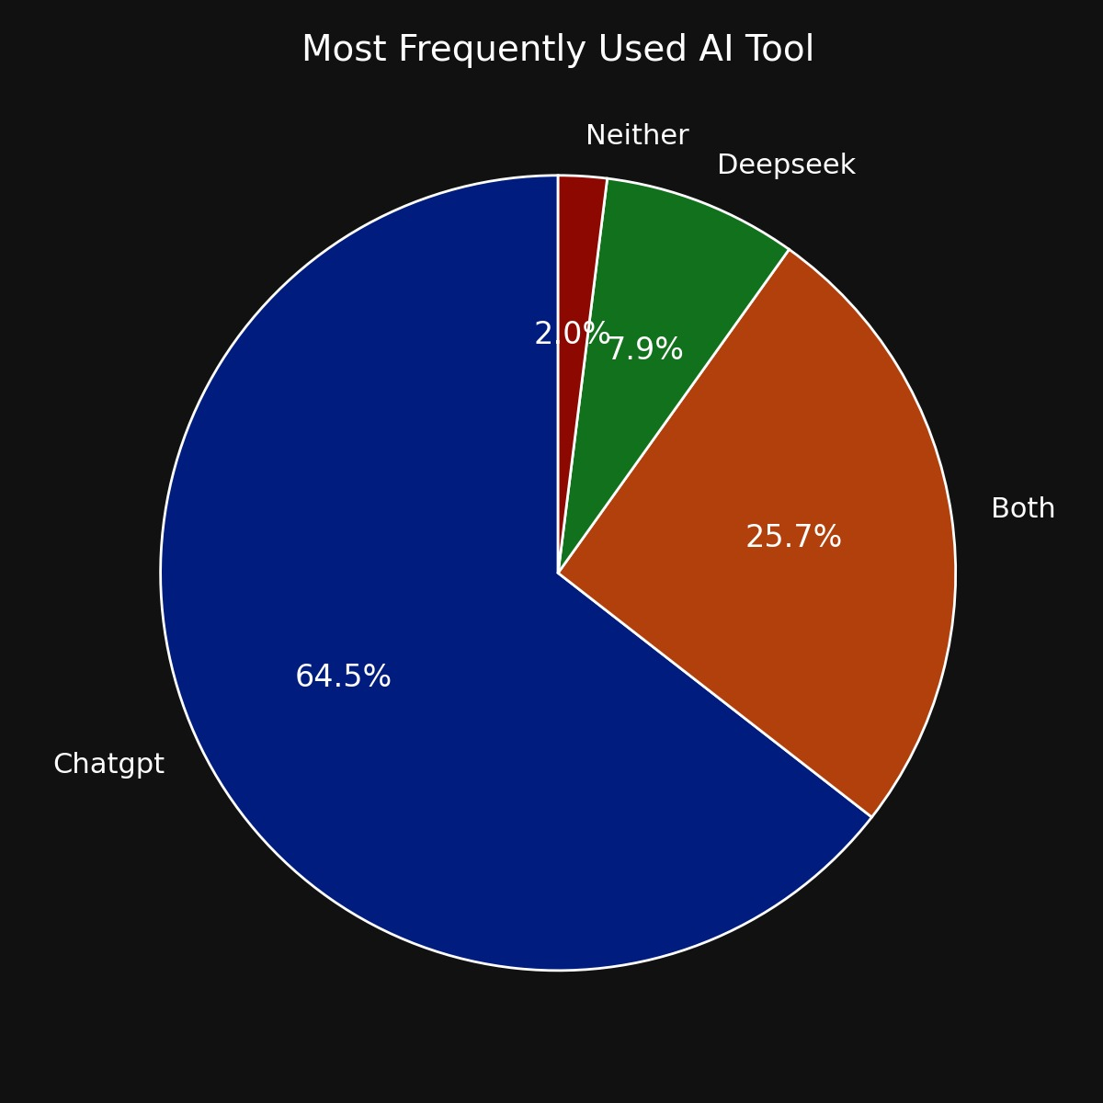
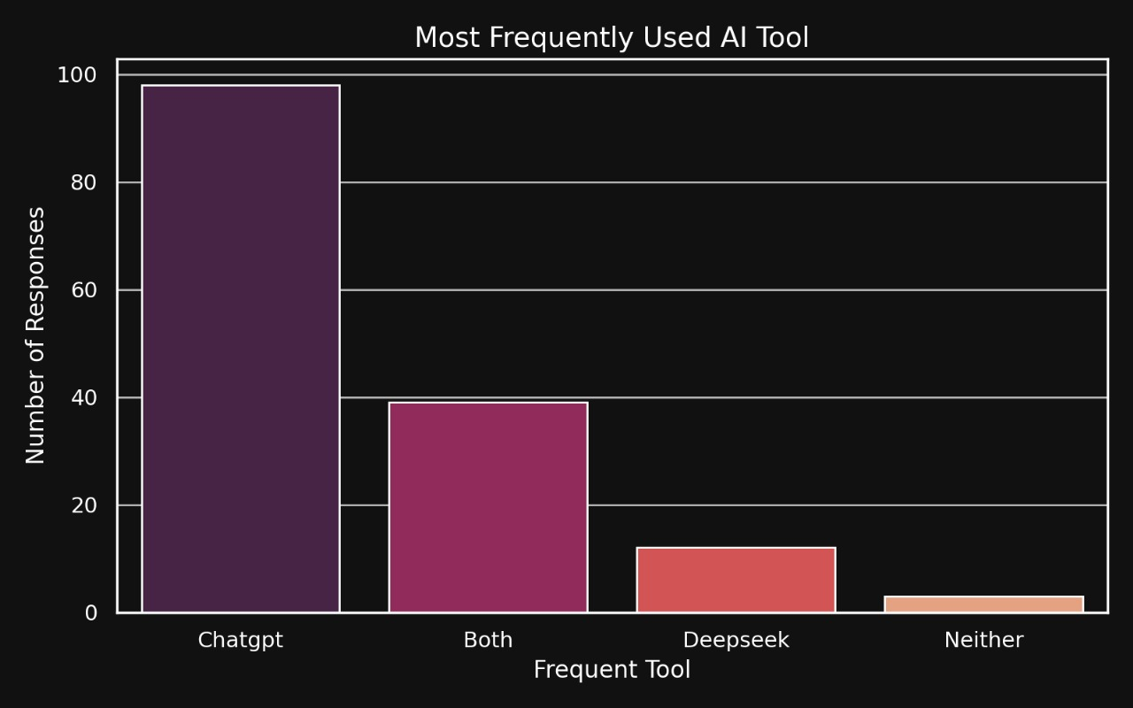
2. Which AI tool do you use more frequently?
Out of 160 responses
98 were in favour of CHATGPT
20 were in favour of DEEPSEEK
33 were in favour of both AIs.
only 5 said neither
CONCLUSION : CHATGPT is most
frequently used AI tool.

Slide 7
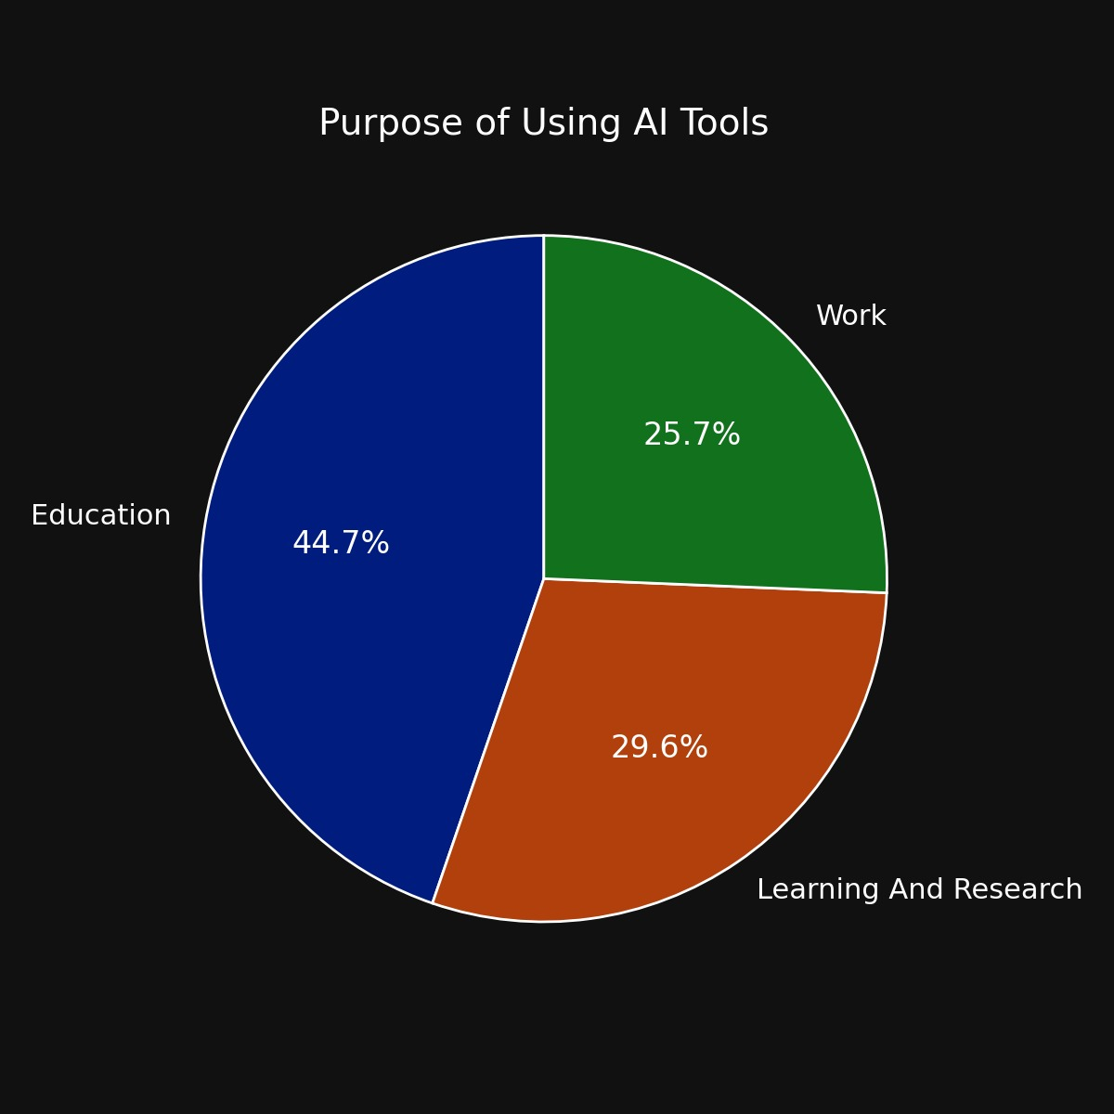
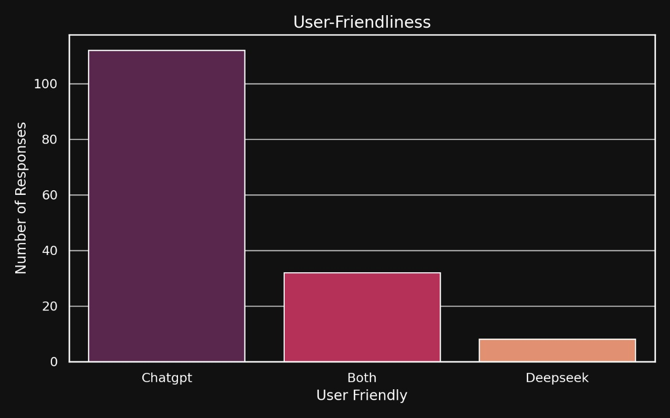
3. Purpose of use and Friendliness (perceived)
a. Majority uses AI for Education
b. CHATGPT is found to be more user friendly

Slide 8
I. Hypothesis Testing: AI Tools Rated "Very High" in Educational Significance
Claim: AI Tools are rated "Very High" in Educational Significance by a majority of users.
H0: p=0.5 (50% of users rate educational significance as "Very High")
H1: p>0.5 (A majority of users rate educational significance as "Very High")
Confidence Level: 95% Significance Level (α): 0.05
Number of users who rated educational significance as "Very High": 106
Total sample size (n): 152
Sample Proportion (p):152/106≈0.697
Calculated Z-statistic (Zcal):≈4.74
Tabulated Z-statistic (Ztab):1.645 (for a one-tailed test at α=0.05)
Conclusion:
Since Zcal(4.74) > Ztab(1.645), we reject the null hypothesis (H0).
There is strong statistical evidence at the 95% confidence level that a majority of users rate AI tools as very significant in education.

Slide 9
II. Hypothesis Testing: ChatGPT Responds Faster than DeepSeek
Claim: ChatGPT responds faster than DeepSeek.
H0: p=0.5 (ChatGPT and DeepSeek are equally fast)
H1: p>0.5 (ChatGPT responds faster than DeepSeek)
Confidence Level: 95% Significance Level (α): 0.05
Number of users who voted ChatGPT faster: 86
Total sample size (n): 152
Sample Proportion (p):152/86≈0.565
Calculated Z-statistic (Zcal):≈1.27
Tabulated Z-statistic (Ztab):1.645 (for a one-tailed test at α=0.05)
Conclusion:
Since Zcal(1.27) < Ztab(1.645), we fail to reject the null hypothesis (H0).
There is not enough statistical evidence at the 95% confidence level to claim that ChatGPT responds faster than DeepSeek.

Slide 10
Claim: DeepSeek is rated more accurate than ChatGPT. H0: p=0.5 (Equal accuracy ratings for DeepSeek and ChatGPT) H1: p>0.5 (DeepSeek rated more accurate than ChatGPT) Confidence Level: 95% Significance Level (α): 0.05 Number of users who rated DeepSeek more accurate: 55 Total sample size (n): 152 Sample Proportion (p): 152/55≈0.362 Calculated Z-statistic (Zcal):≈-2.79 Tabulated Z-statistic (Ztab): 1.645 (for a one-tailed test at α=0.05) Conclusion: Since Zcal(-2.79) < Ztab(1.645), we fail to reject the null hypothesis (H0). There is no significant statistical evidence at the 95% confidence level to claim that DeepSeek is rated more accurate than ChatGPT. In fact, based on the sample proportion, ChatGPT appears to be rated more accurate
III. Hypothesis Testing : DeepSeek Rated More Accurate than ChatGPT

Slide 11
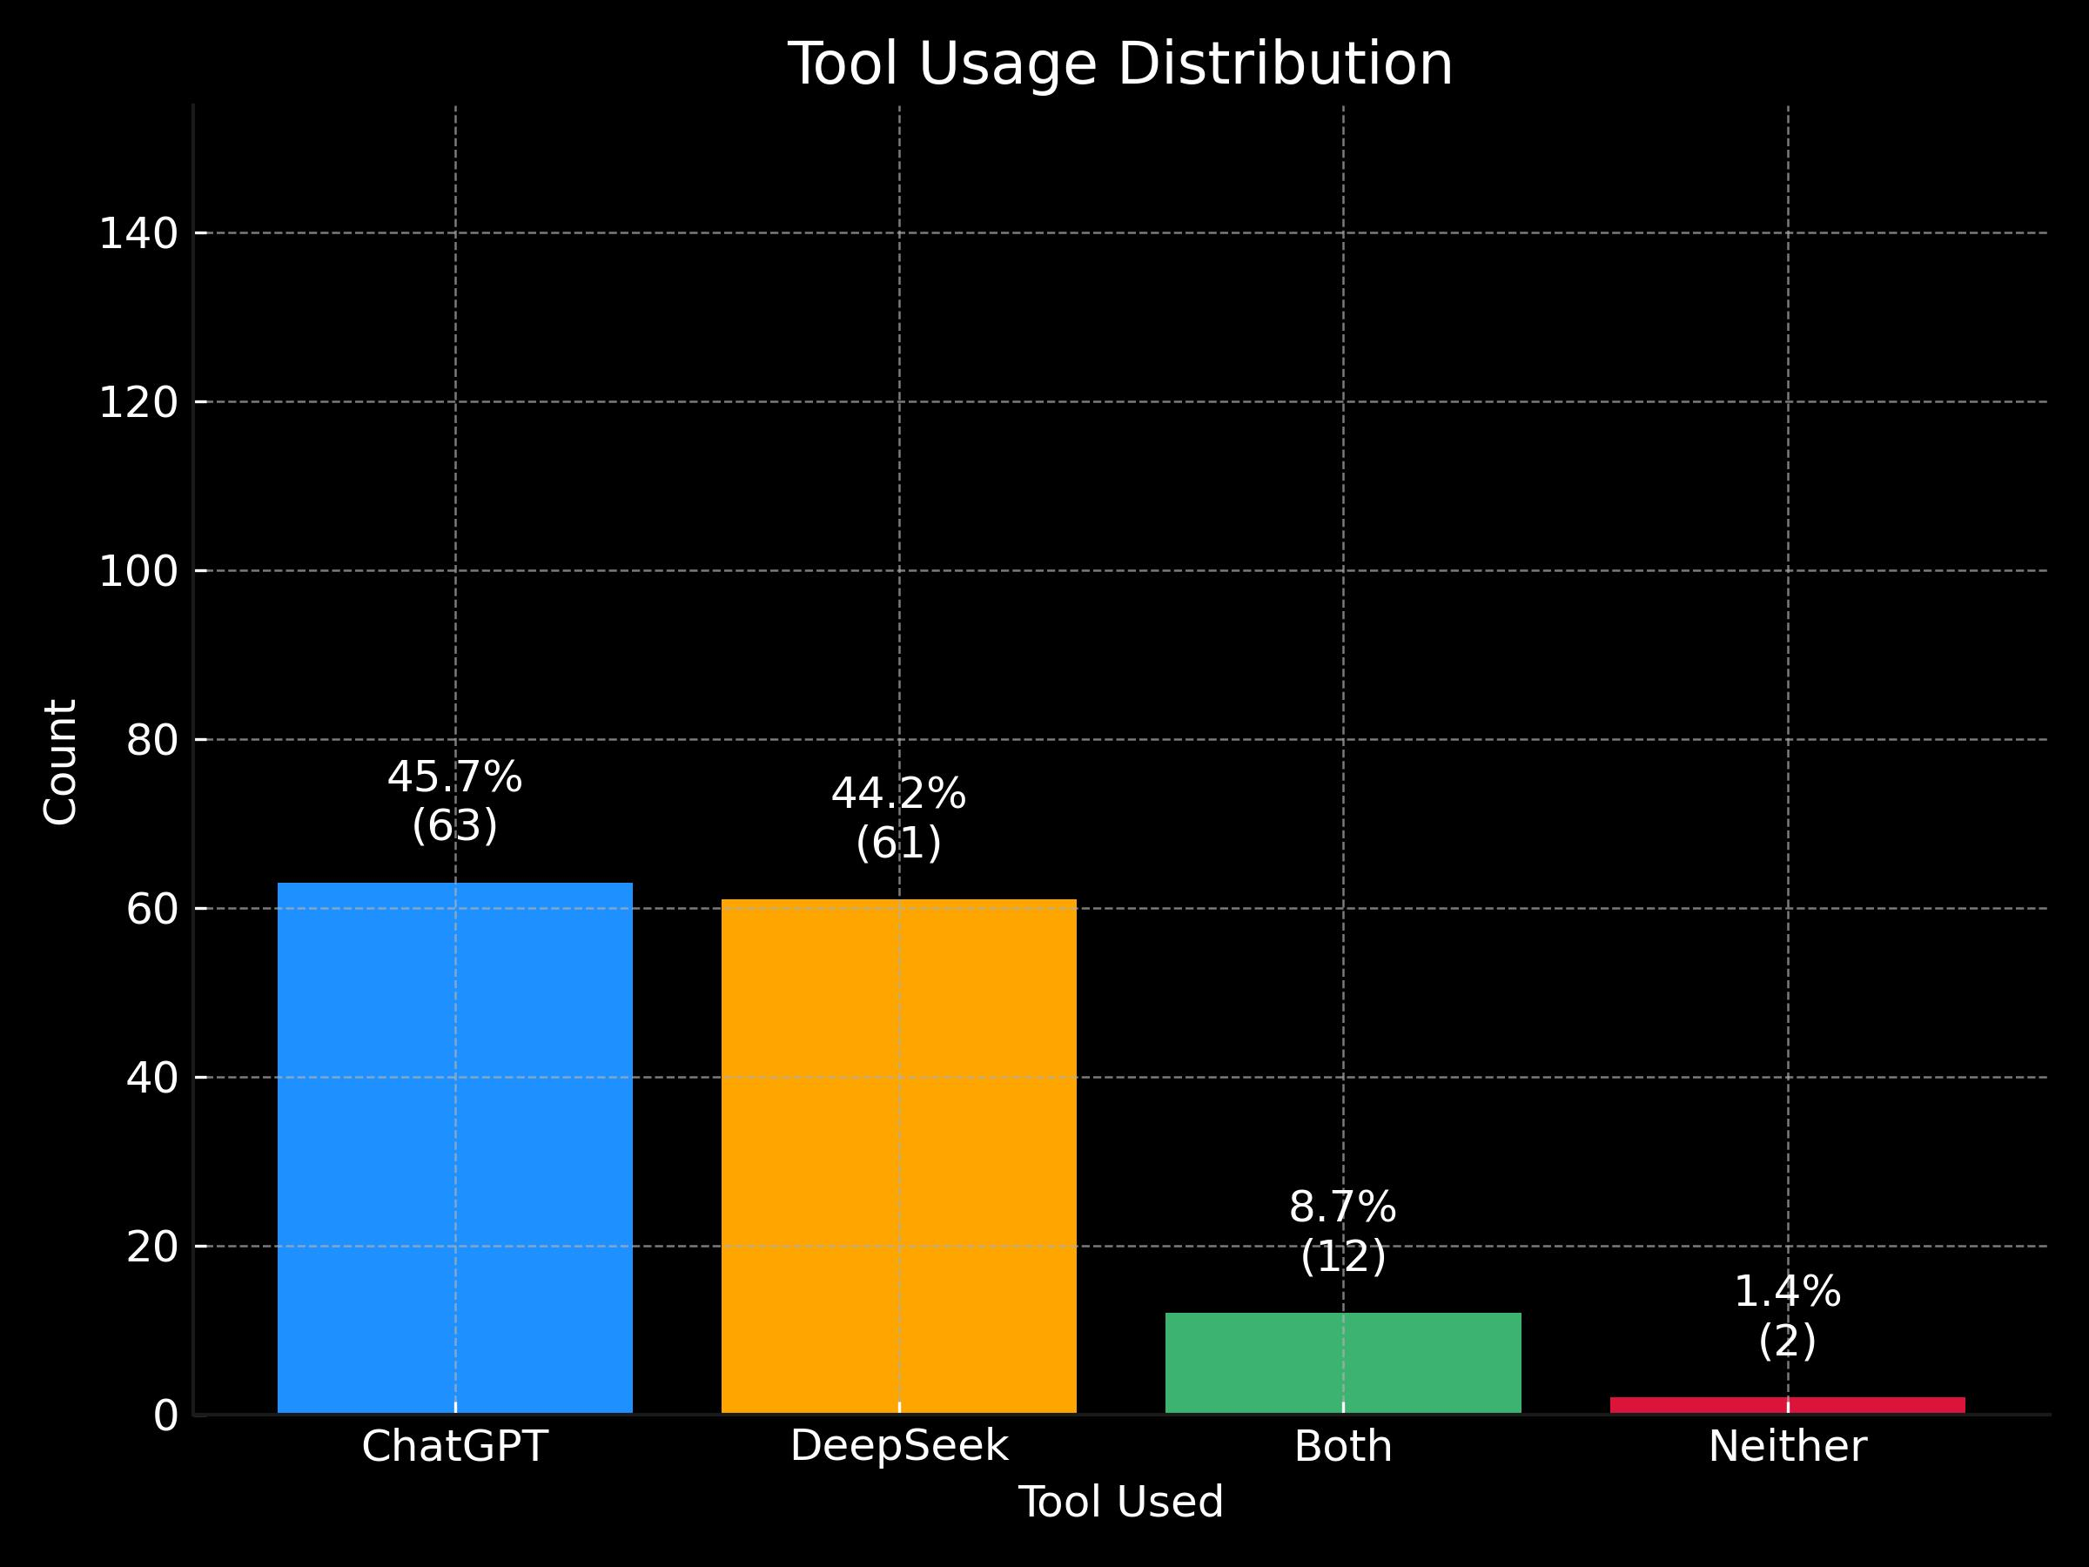
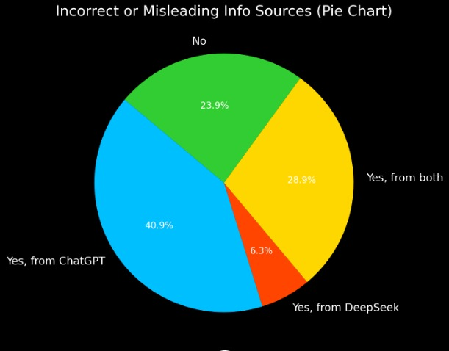
4. PERFORMANCE:
Have you ever received incorrect or misleading information from ChatGPT or DeepSeek?
Which tool do you think handles complex or technical queries better?

Slide 12
This hypothesis examines whether the proportion of users who received incorrect/misleading information from AI tools is greater than 50%. CLAIM: Null Hypothesis (H0):p=0.5 Alternative Hypothesis (H1):p>0.5 Total responses (n): 159 Number who reported incorrect/misleading information (x): 121 Sample Proportion (p): 0.761 Hypothesized population proportion under null hypothesis (p0): 0.5 Calculated Z-statistic (Zcal): 6.58 Tabulated Z-statistic (Ztab): 1.645 (for a one-tailed test at α=0.05) Conclusion: Since Zcal(6.58)>Ztab(1.645), we reject the null hypothesis (H0). At a 5% level of significance, there is strong statistical evidence to conclude that the proportion of users who received incorrect or misleading information from ChatGPT or DeepSeek is significantly greater than 50%
IV. HYPOTHESIS TESTING: Proportion of Incorrect/Misleading Information Received

Slide 13
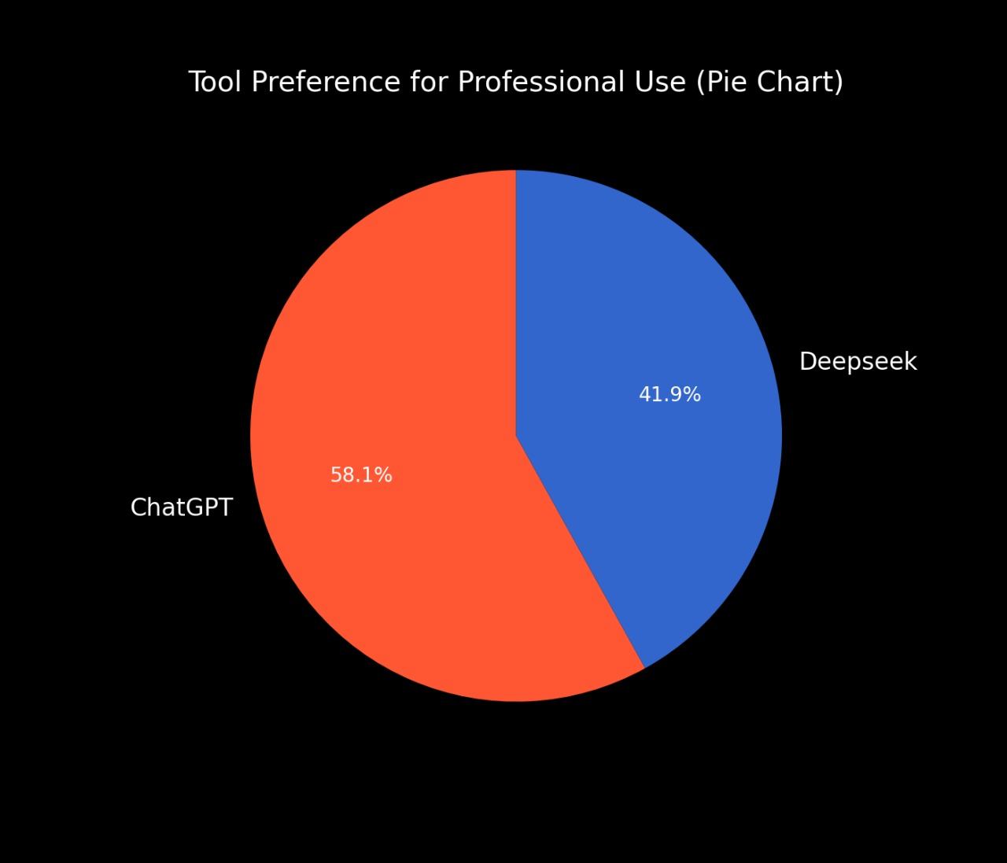
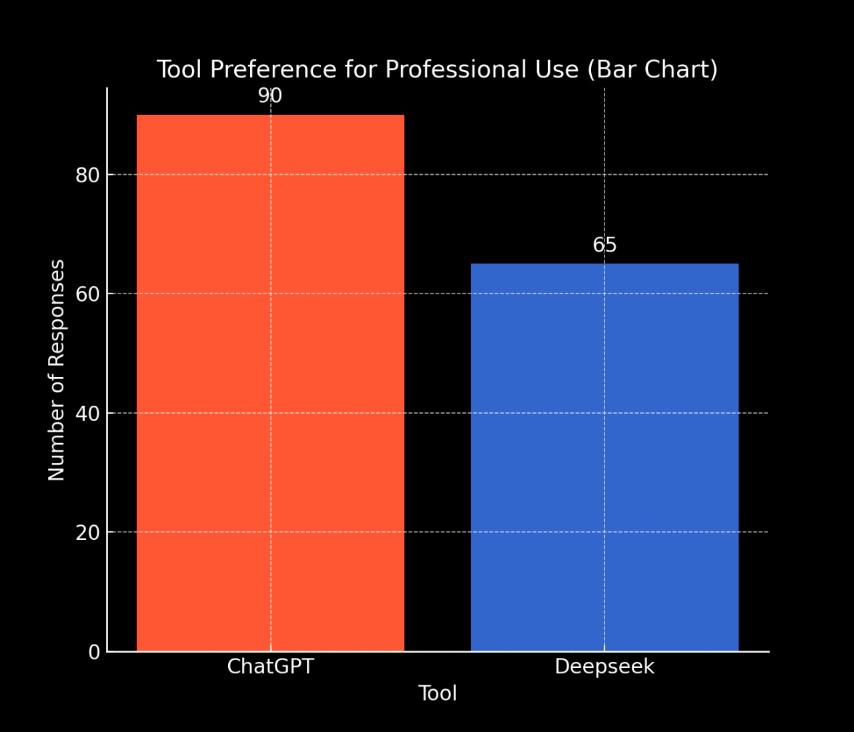
6. If you had to choose one tool for professional use, which would it be ?
CONCLUSION:
Majority of people preferred CHATGPT over DEEPSEEK for Professional purposes.

Slide 14
V. Hypothesis Testing: Preference for ChatGPT for Professional Use
Claim: More than 50% of users prefer ChatGPT for professional use.
H0: p=0.5 (50% prefer ChatGPT for professional use)
H1: p>0.5 (More than 50% prefer ChatGPT for professional use)
Confidence Level: 95% Significance Level (α): 0.05
Number of users who preferred ChatGPT for professional use: 100
Total sample size (n): 152
Sample Proportion (p^):152/100≈0.658
Calculated Z-statistic (Zcal):≈3.26
Tabulated Z-statistic (Ztable): 1.645 (critical value at 95% confidence for a one-tailed test)
Conclusion:
Since Zcal(3.26) > Ztable(1.645), we reject the null hypothesis (H0).
There is significant statistical evidence at the 95% confidence level that more than 50% of users prefer ChatGPT for professional use.

Slide 15
7. If you had to choose one tool for non-professional use, which would it be?
CONCLUSION:
Majority of people preferred CHATGPT over DEEPSEEK for Professional purposes

Slide 16
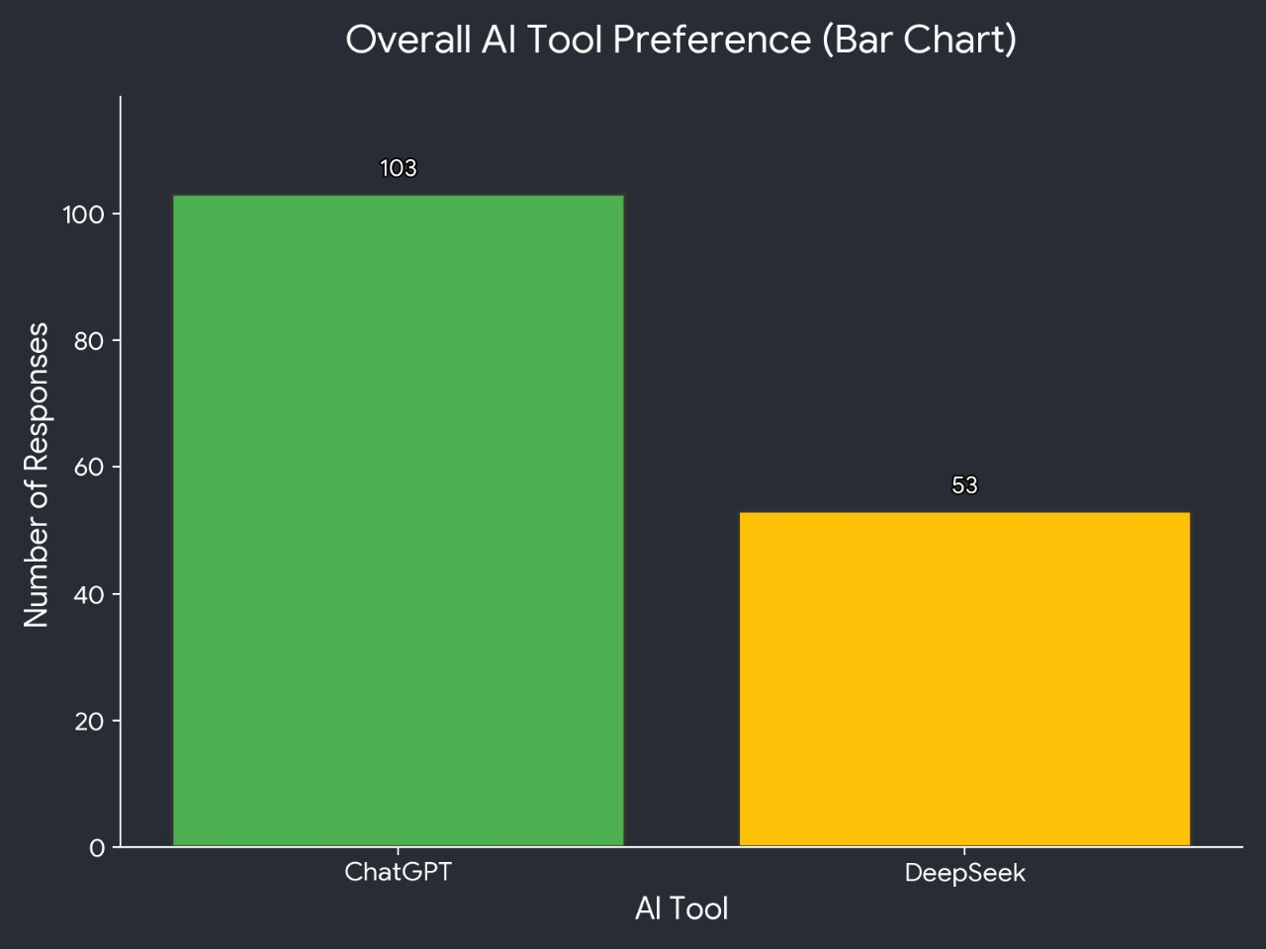
8. If you had to choose one tool Overall, irrespective of professional or non professional use which would it be ?

Slide 17
Null Hypothesis (H0):p=0.5 Alternative Hypothesis (H1):p=0.5 Total responses (n): 156 ChatGPT responses (x): 103 Proportion in favor of ChatGPT (p): 0.660 Confidence Level: 95% Significance Level (α): 0.05 Calculated Z-statistic (Zcal): 5.02 Tabulated Z-statistic (Ztab):1.96 Conclusion: Since Zcal(5.02)>Ztab(1.96), we reject the Null Hypothesis (H0). At a 95% confidence level and 5% significance, there is a statistically significant preference for ChatGPT over DeepSeek for overall use.
VI. Hypothesis Testing: Preference for AI Tool in overall use

Slide 18
🧭 Conclusion:
1.ChatGPT is the more popular, user-friendly, and versatile tool 2.DeepSeek earns praise in technical reliability 3.Use-case matters: Casual = ChatGPT, Technical = DeepSeek 4.AI tools are now essential aids in both academic and professional life

Slide 19
Thank you!
We hope this gave clear insights into how
AI tools are shaping modern work and learning

